Slide 1
Course Introduction
Sungjoon Choi
(sungjoon.choi@cpslab.snu.ac.kr)

Slide 2

Deep learning
RNN / LSTM
CNN
ANN
RBM

Slide 3
To tell the truth

Slide 4
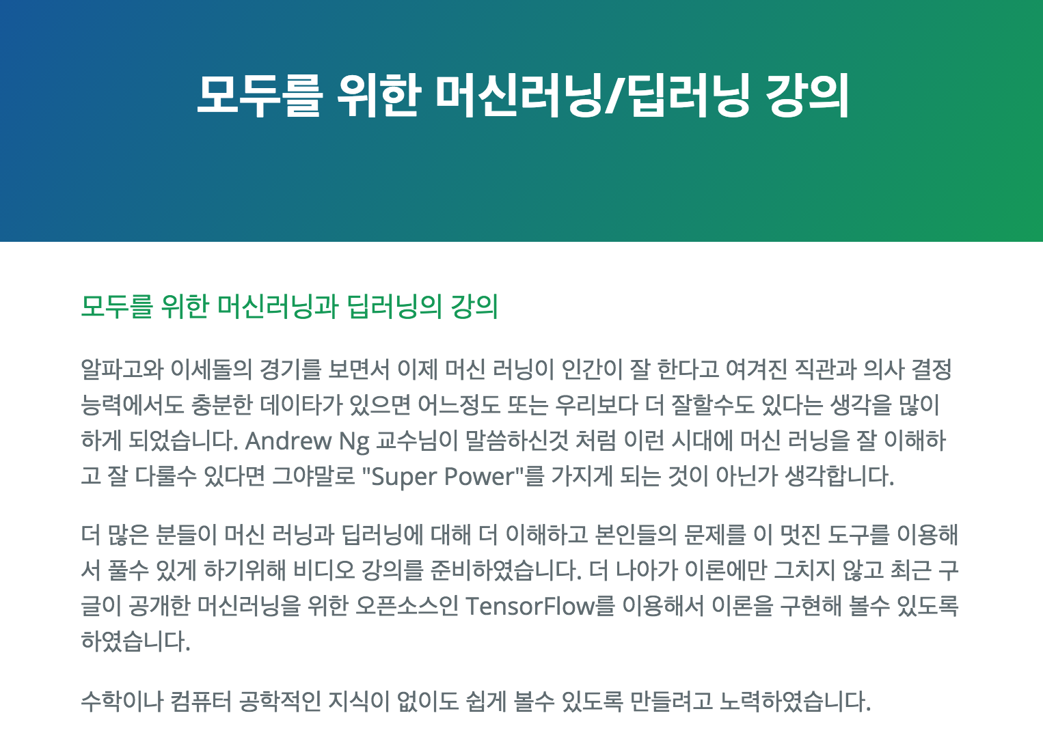
Deep learning tutorial
http://hunkim.github.io/ml/

Slide 5
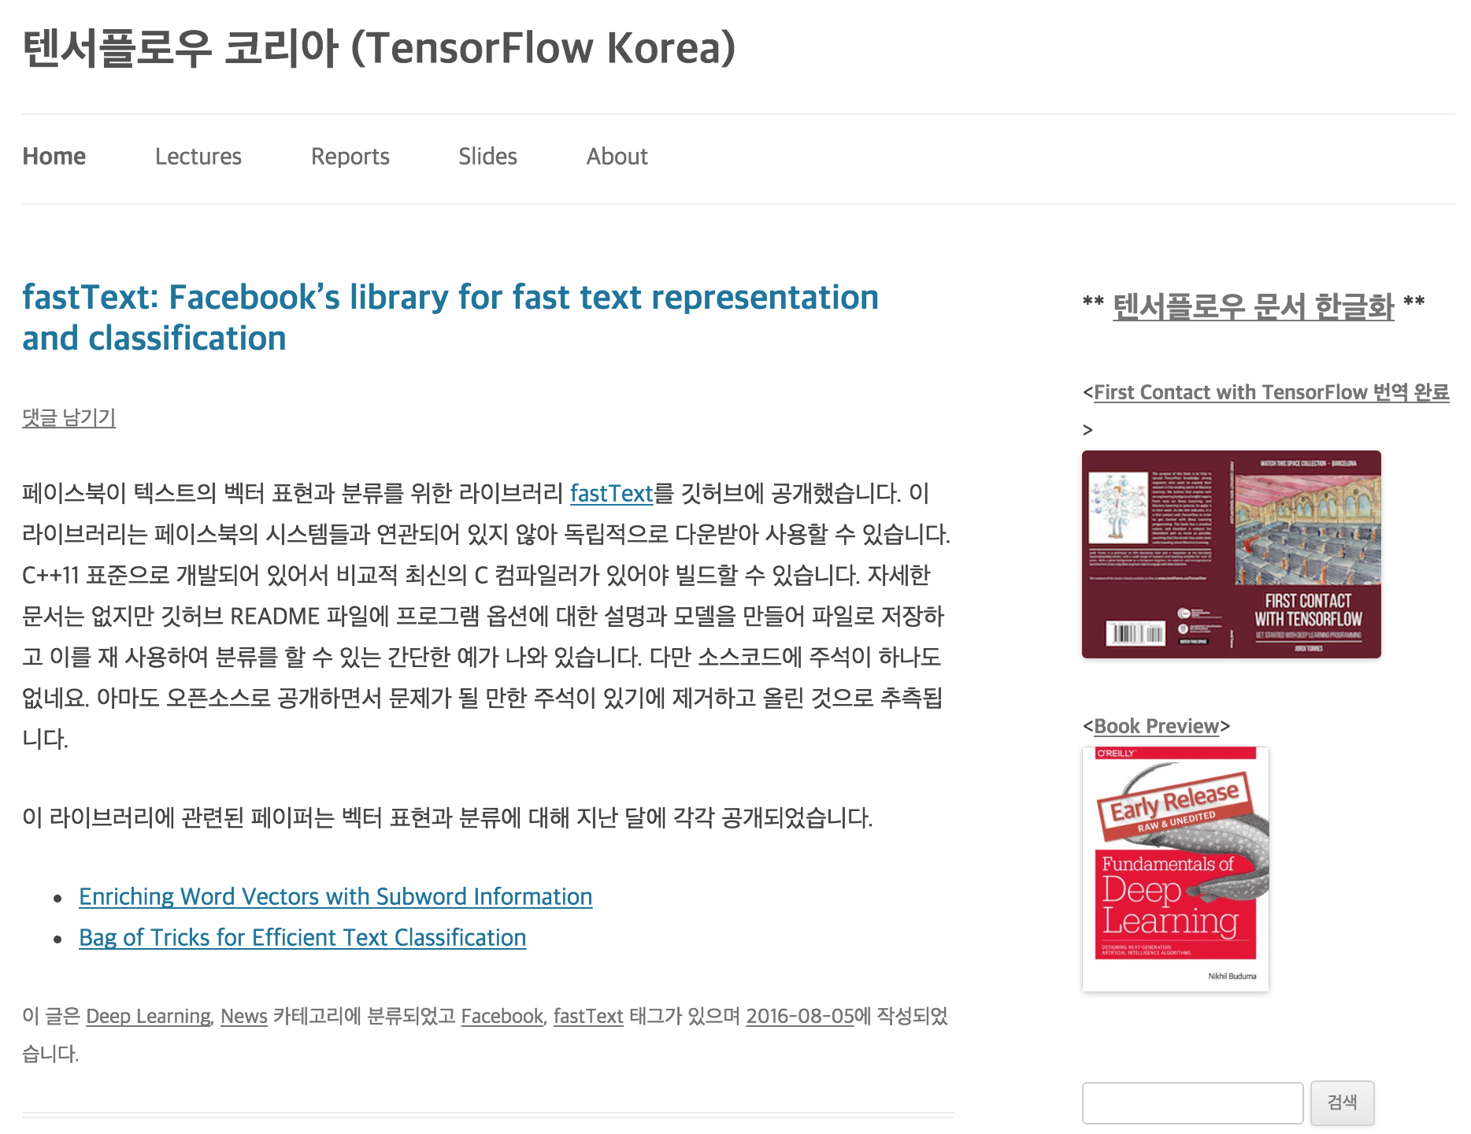
Deep learning tutorial
https://tensorflowkorea.wordpress.com

Slide 6
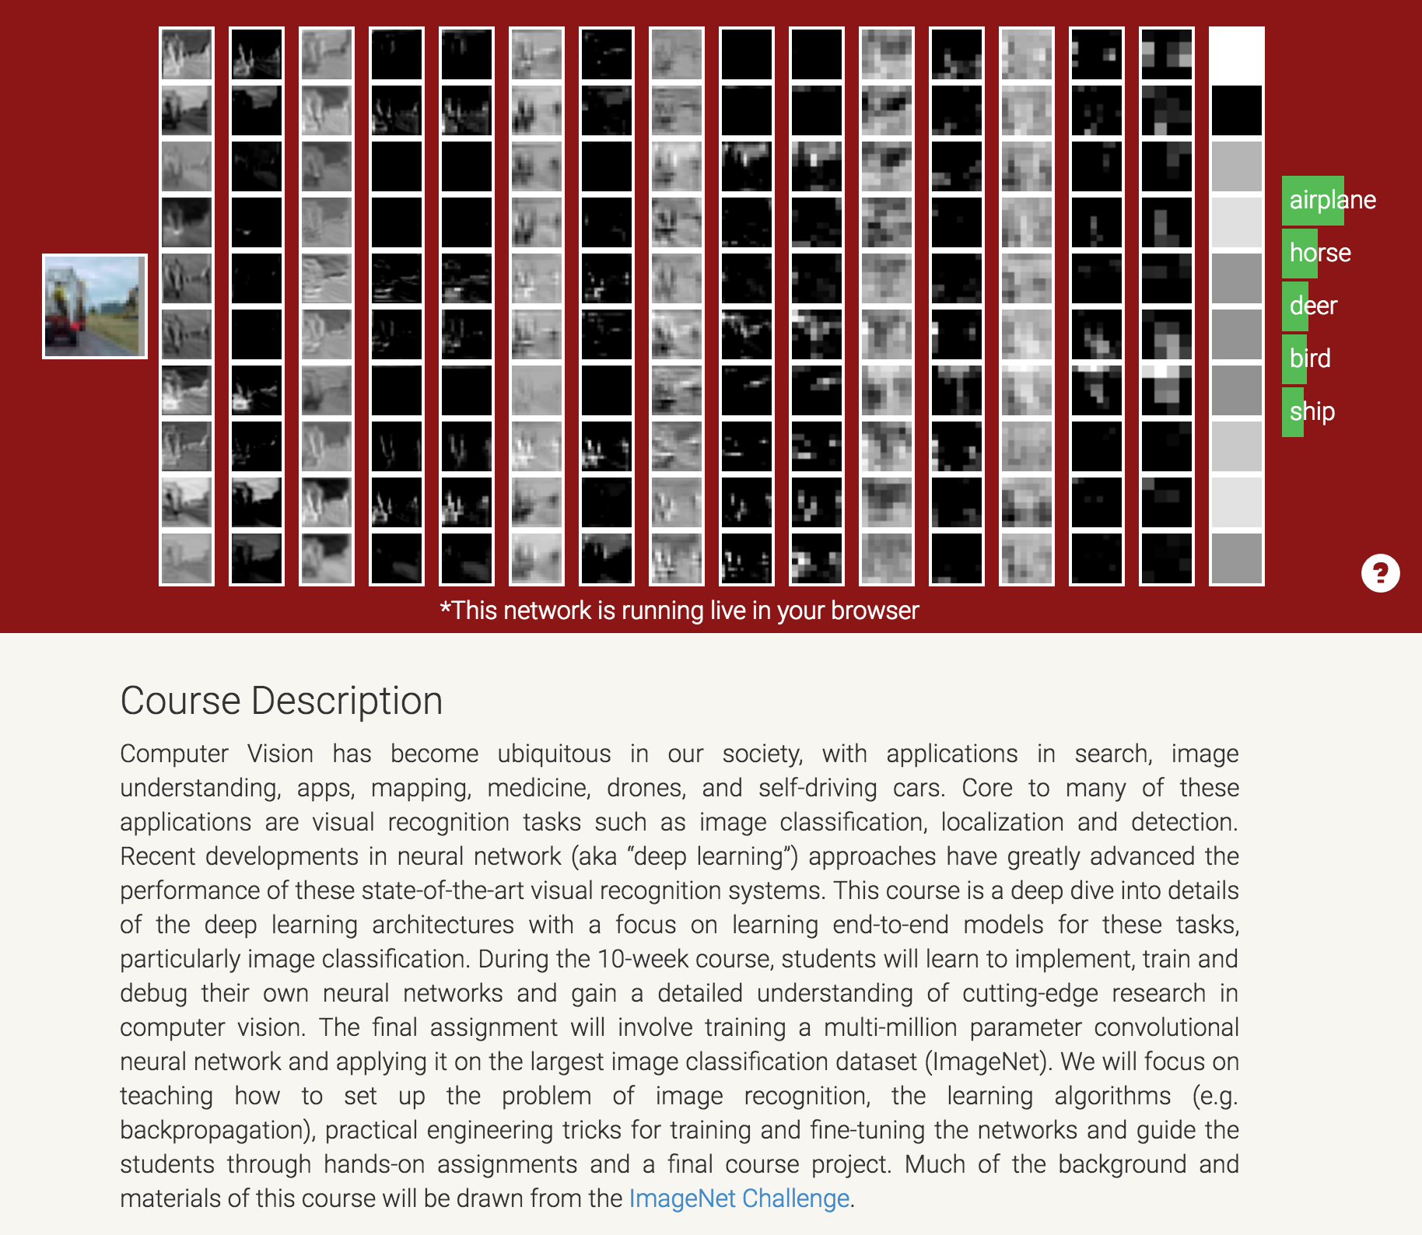
Deep learning tutorial
http://cs231n.stanford.edu/

Slide 7
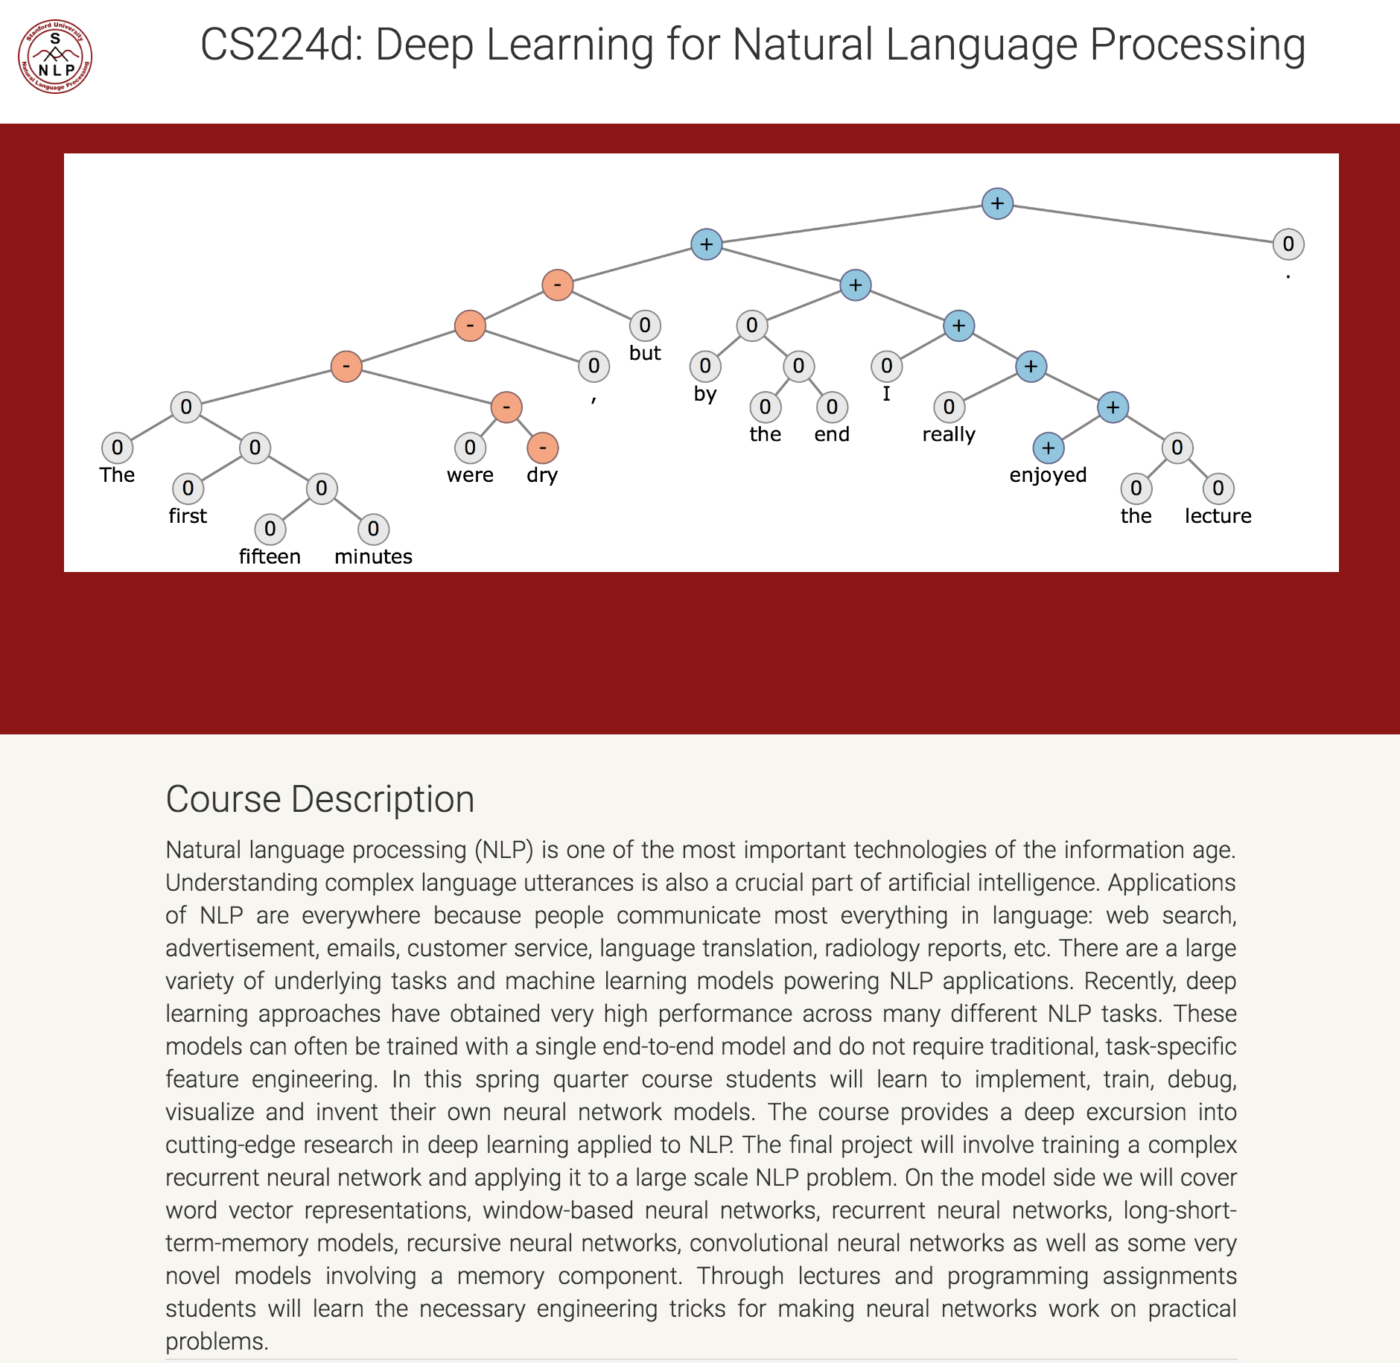
Deep learning tutorial
http://cs224d.stanford.edu/

Slide 8
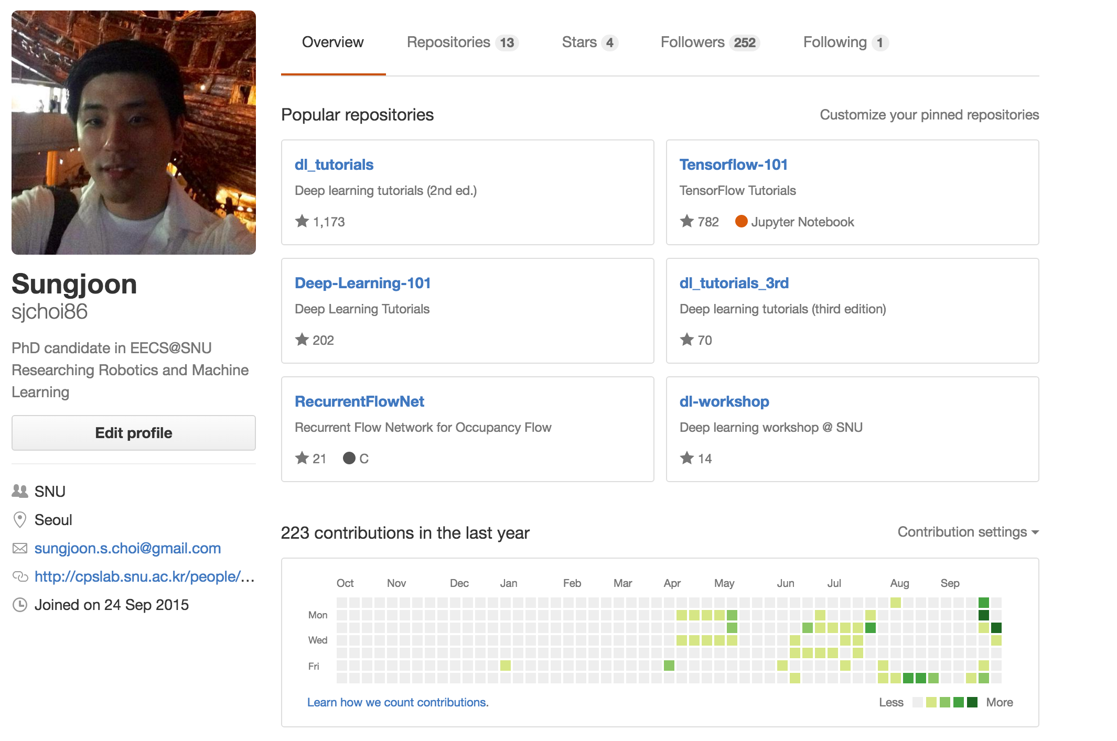
Deep learning tutorial
https://github.com/sjchoi86

Slide 9
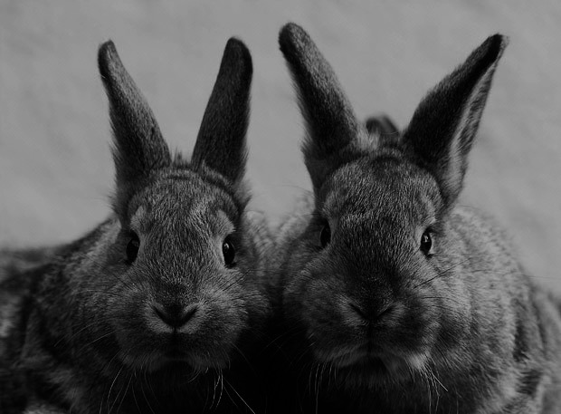
Goal
Deep Learning
Theories
TensorFlow
Implementation

Slide 10





SNS
?

Slide 11

Be social

Slide 12
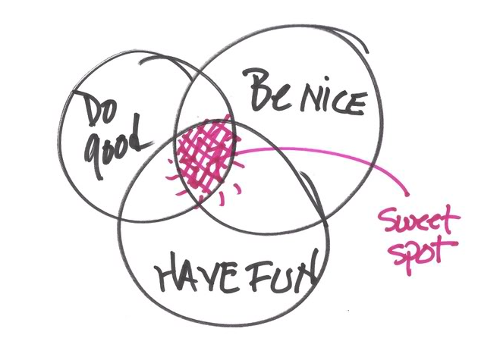
More importantly,

Slide 13
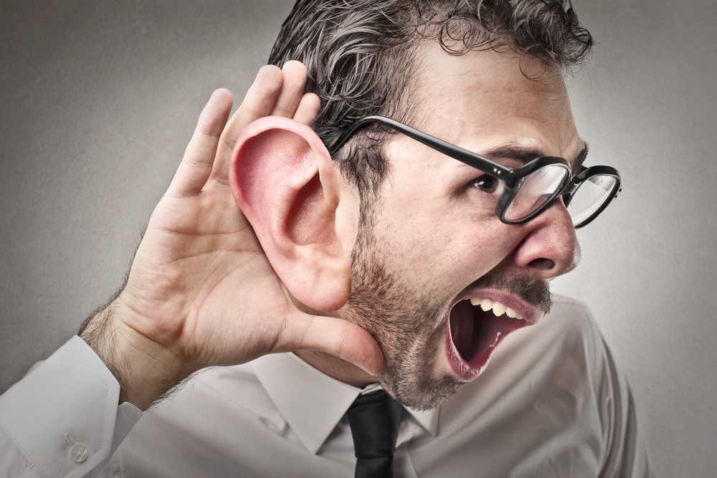
Most importantly,

Slide 14
What we will learn in this course

Slide 15
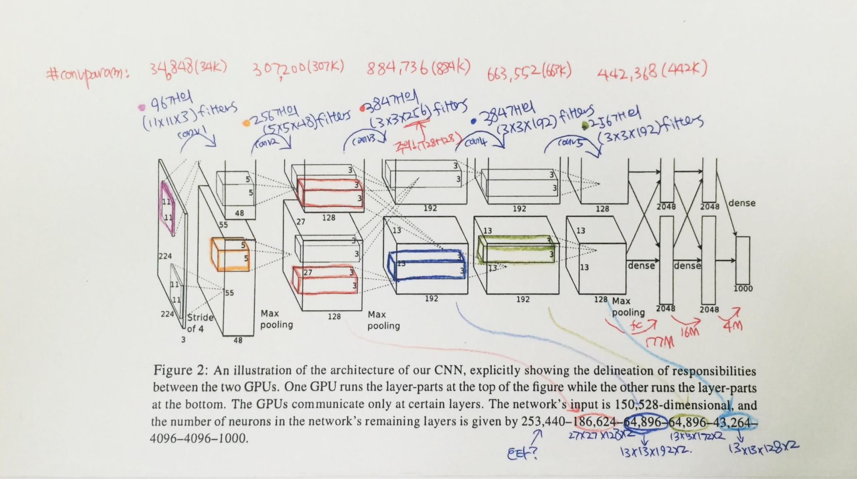
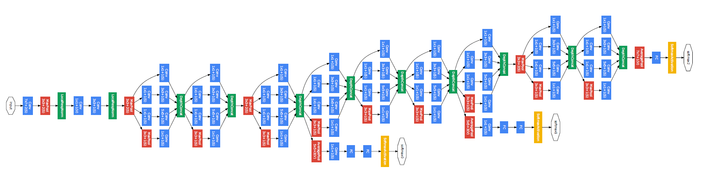
Convolutional neural network
AlexNet
GoogleLeNet

Slide 16
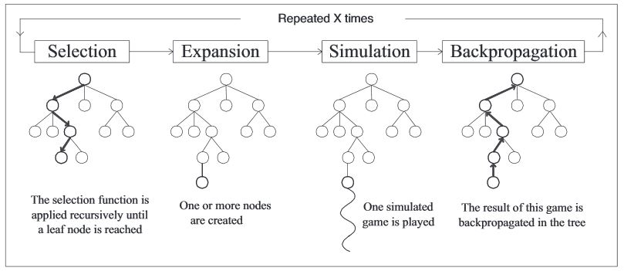
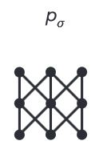
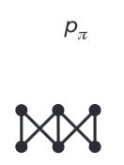
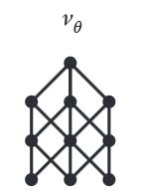
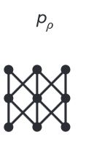
Algorithms behind AlphaGo
Rollout net
Value net
RL net
SL Policy Network

Slide 17

Regularization
Main purpose is to avoid “OverFitting”

Slide 18


Optimization methods

Slide 19
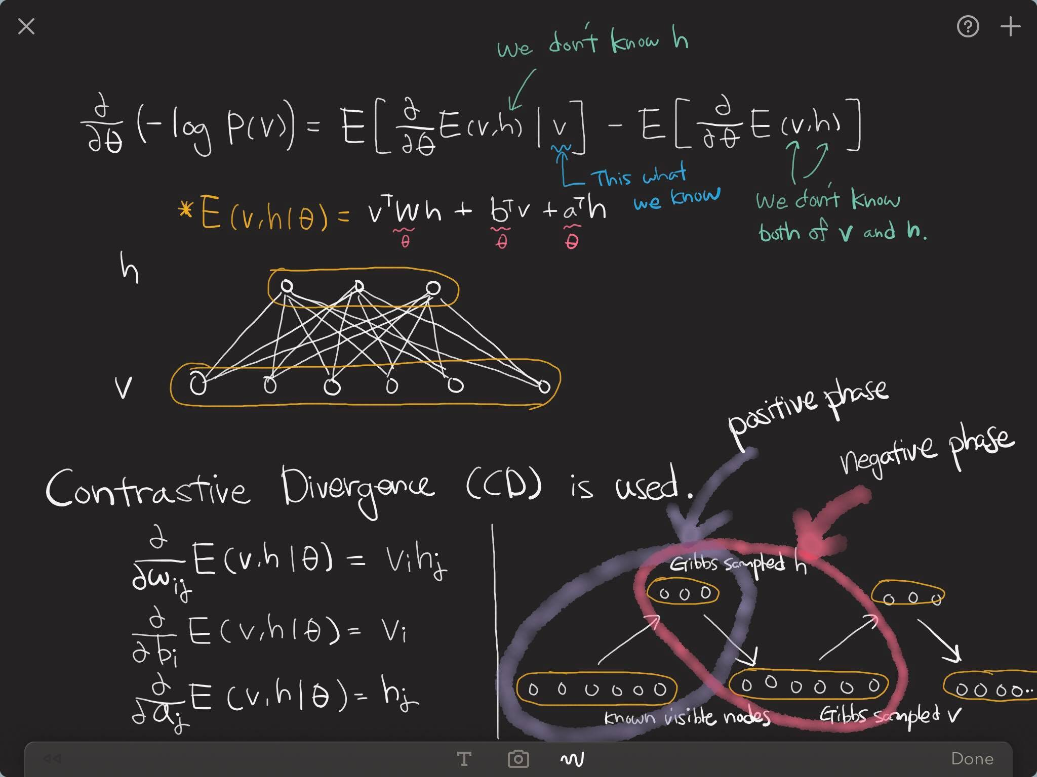
Restricted Boltzmann machine

Slide 20
Denoising auto-encoder

Slide 21
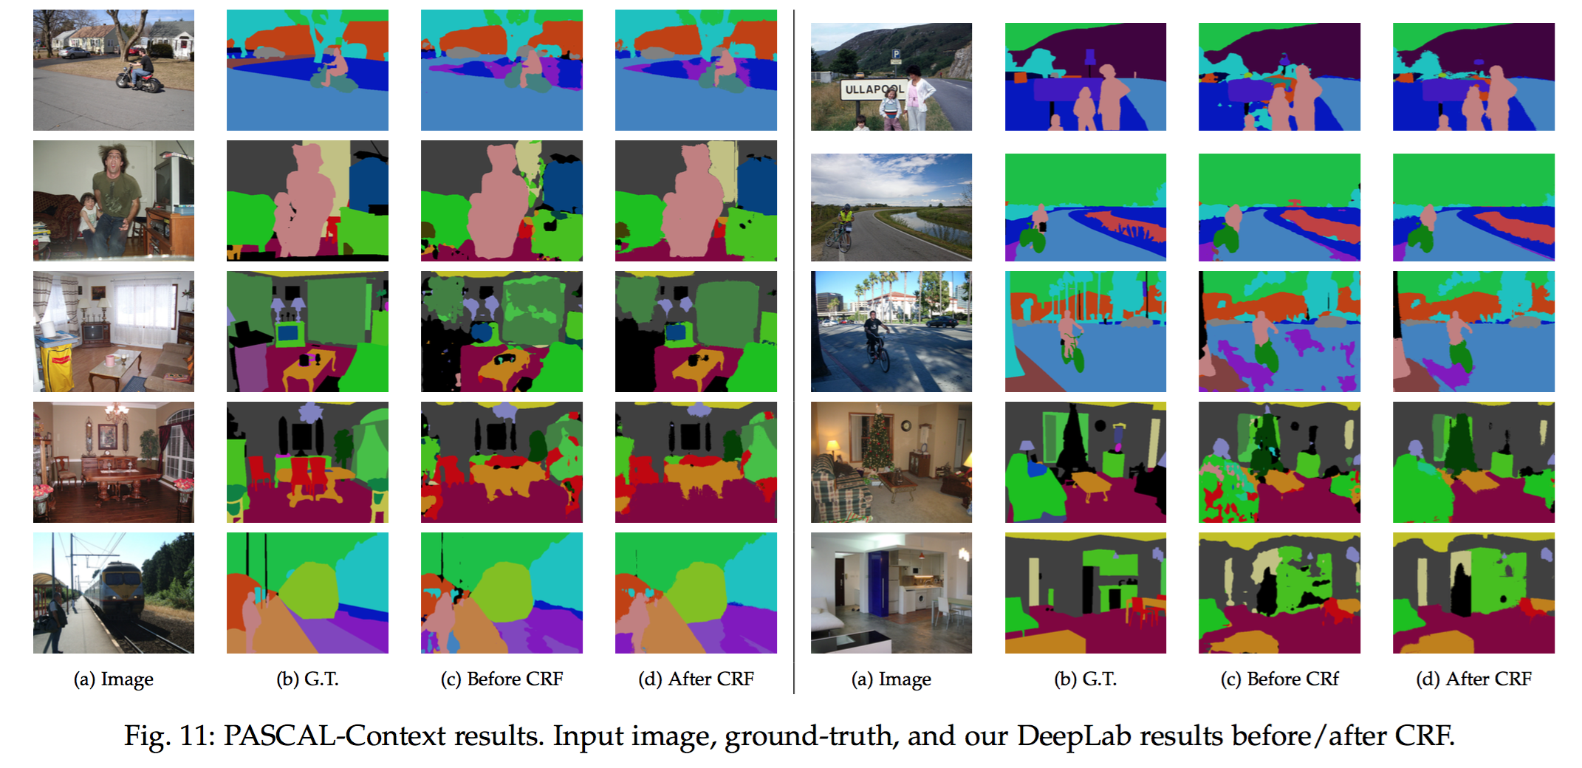
Semantic segmentation

Slide 22
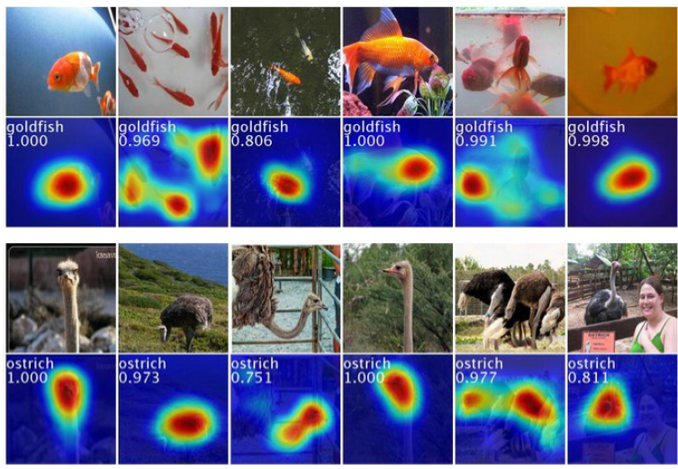
Weakly-supervised localization

Slide 23
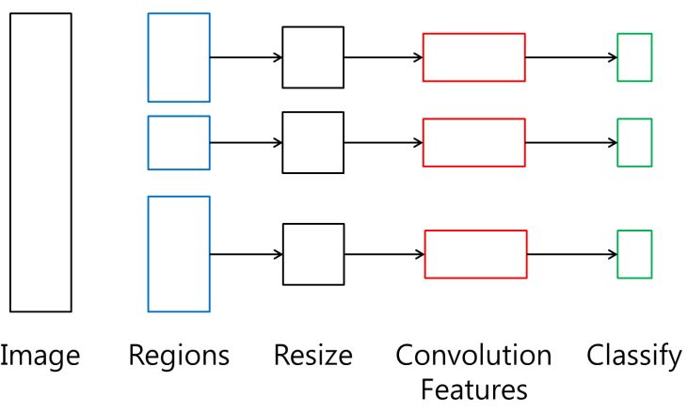
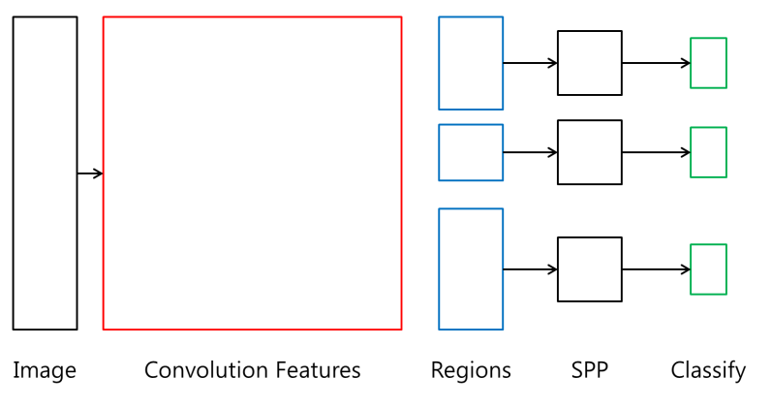
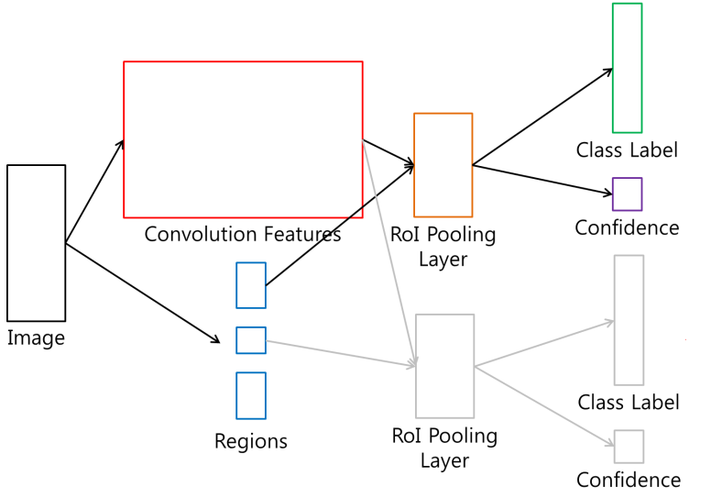
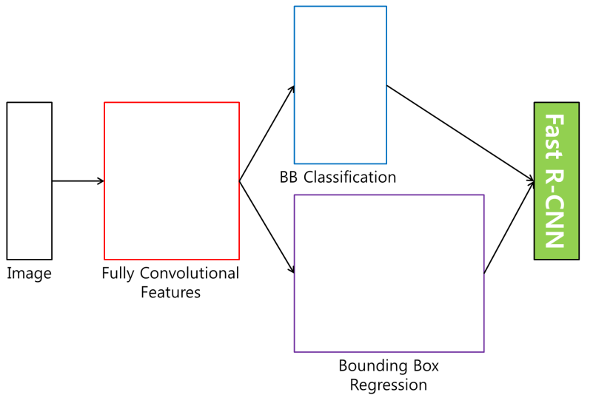
Detection
R-CNN
SPP net
Fast R-CNN
Faster R-CNN

Slide 24

RNN - LSTM
Output
Forget Gate
(Cell) state
Next (Cell) State
Input Gate
Output Gate
Hidden State
Next Hidden State
Input
Output = Hidden state
24
http://colah.github.io/posts/2015-08-Understanding-LSTMs/

Slide 25
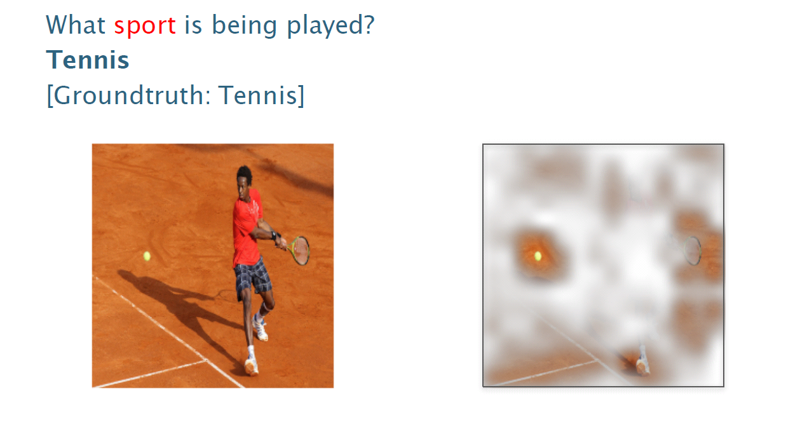
Visual Q&A

Slide 26
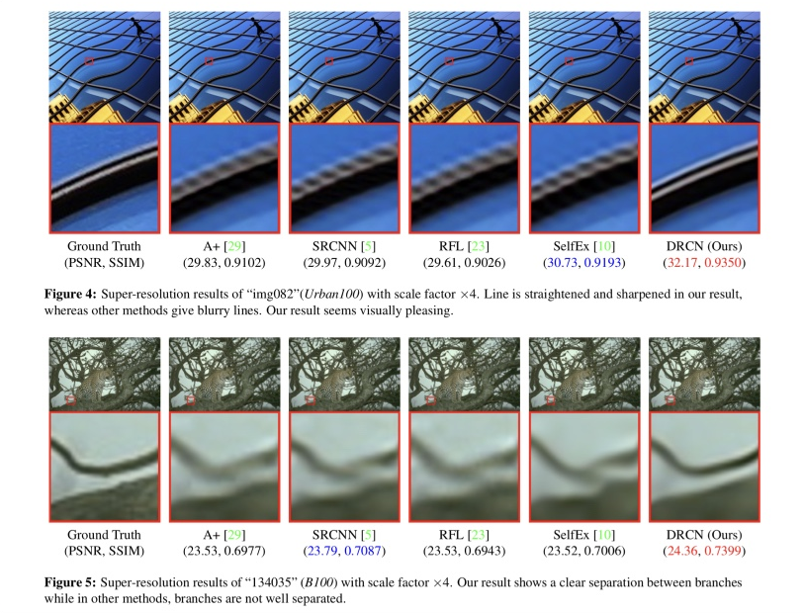
Super resolution

Slide 27
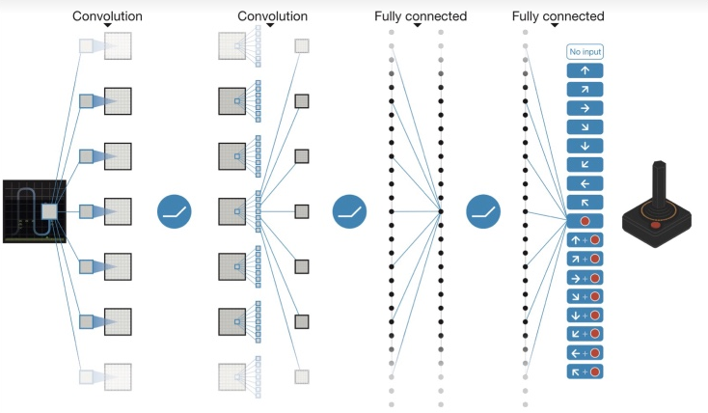
Deep reinforcement learning

Slide 28
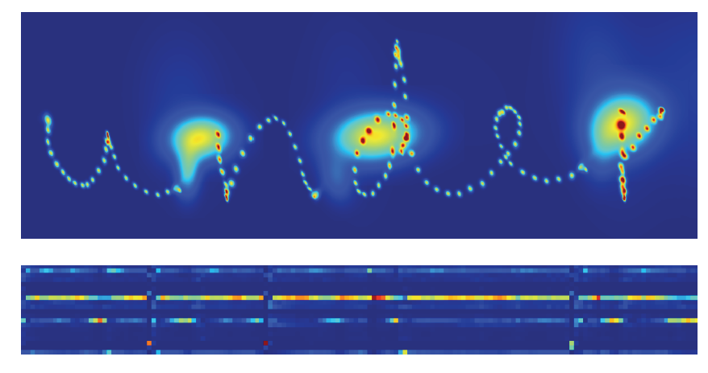
Handwriting generation

Slide 29
Word embedding

Slide 30
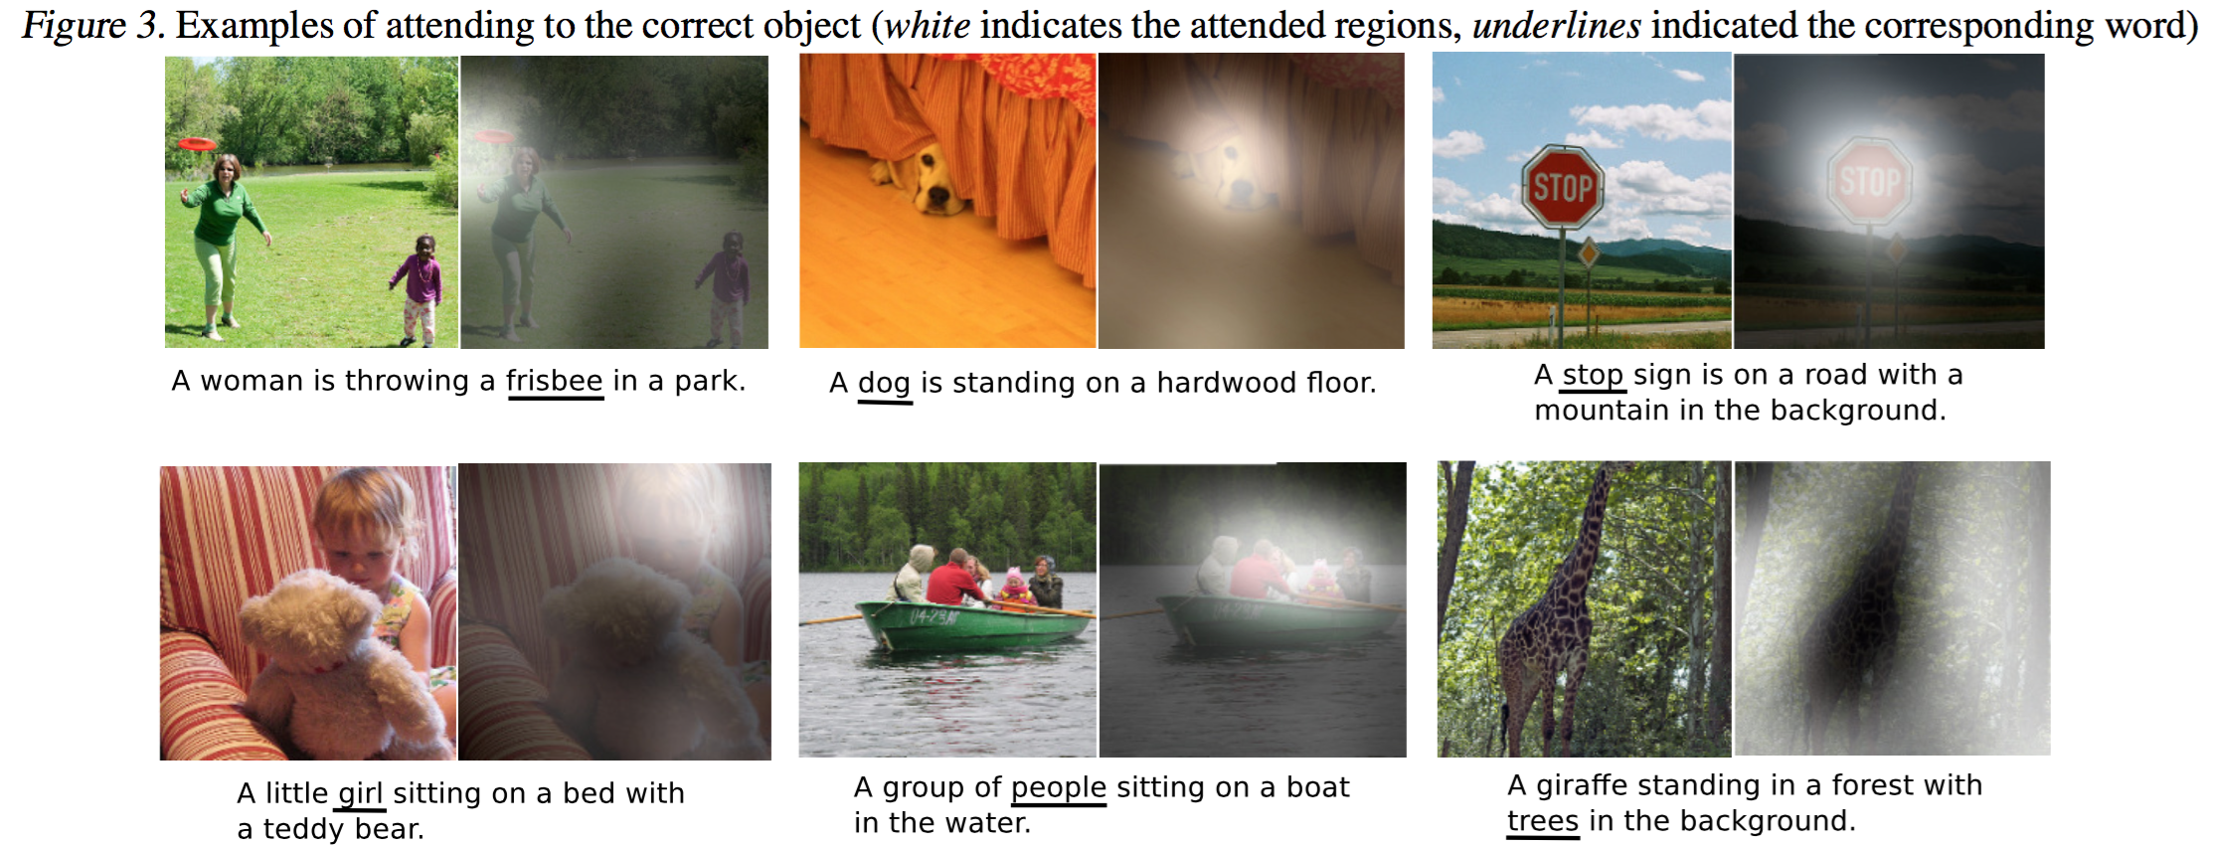
Image captioning

Slide 31
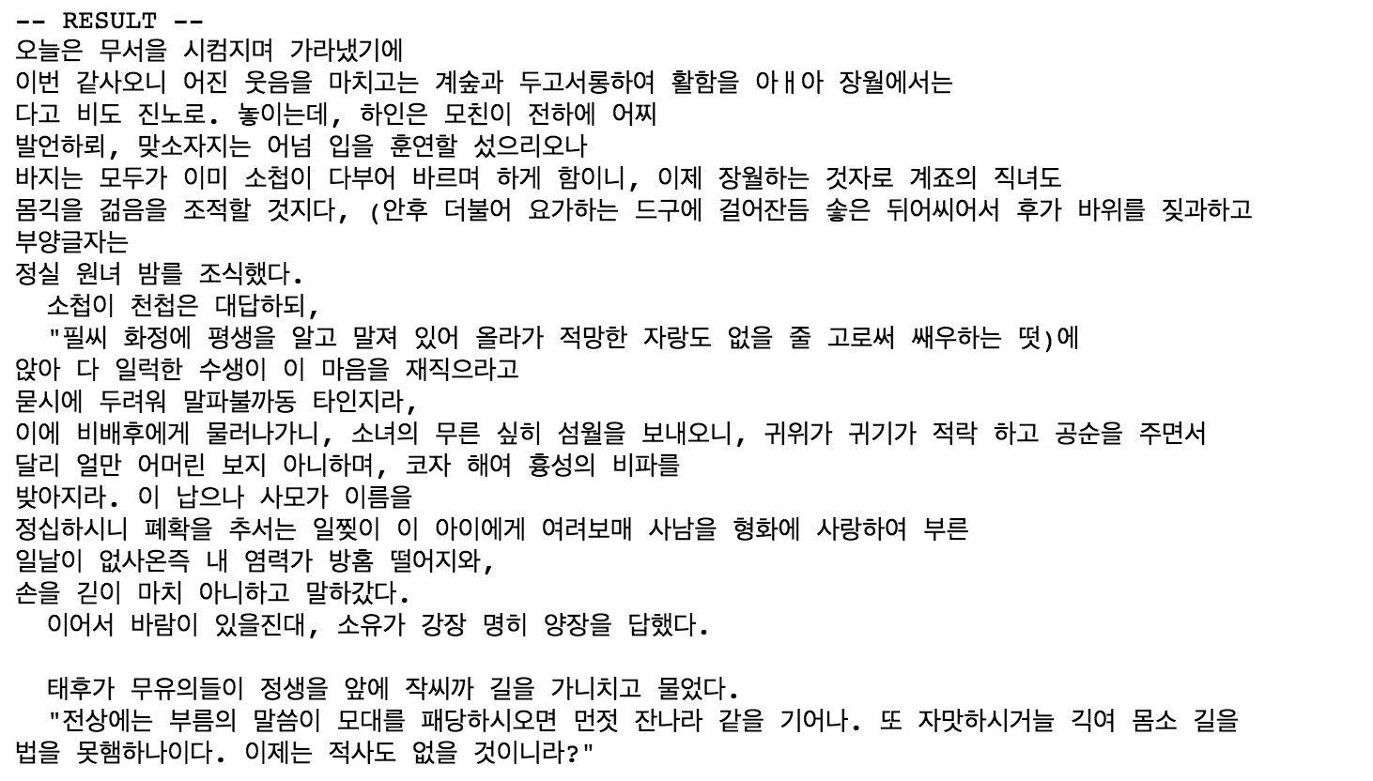
Hangul-RNN

Slide 32
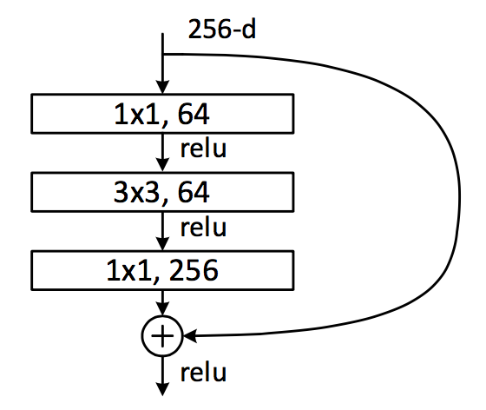
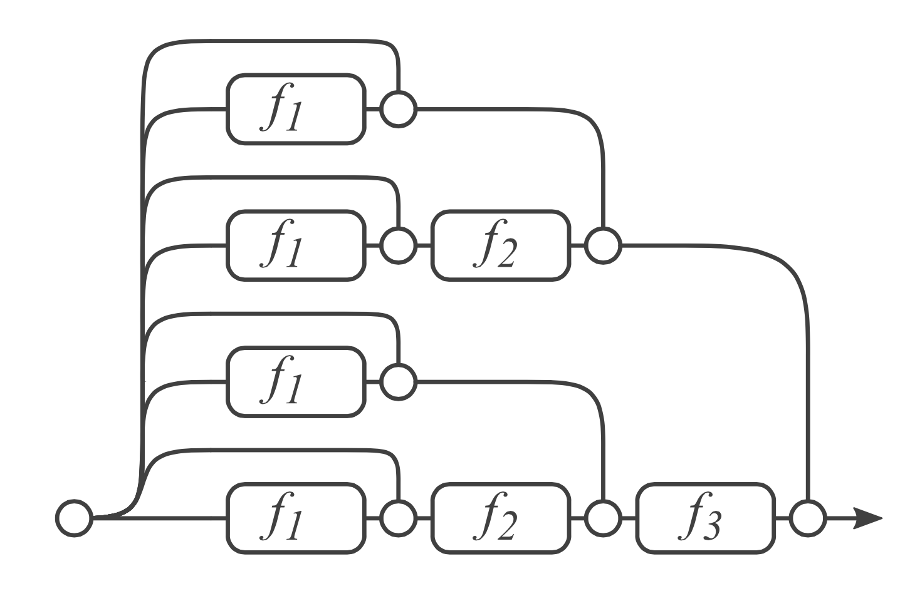
Residual Network & analyses
Dimension reduction
Convolution
Dimension increasement

Slide 33
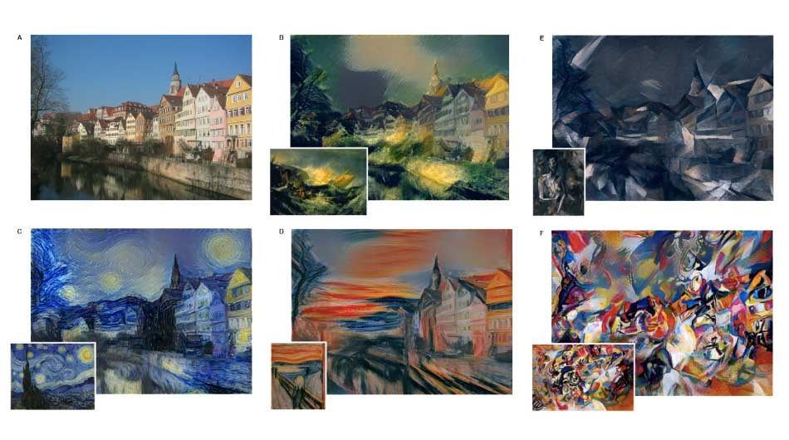
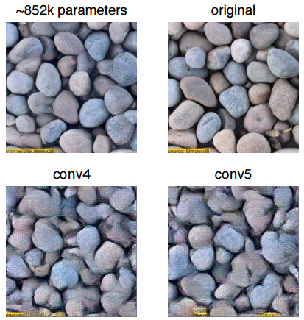
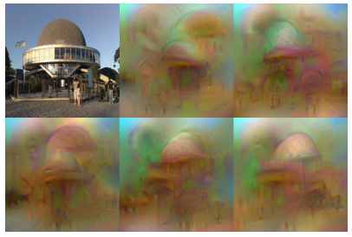
Neural Style
Texture Synthesis Using Convolutional Neural Networks
NIPS2015
Understanding Deep Image Representations by Inverting Them
CVPR2015

Slide 34
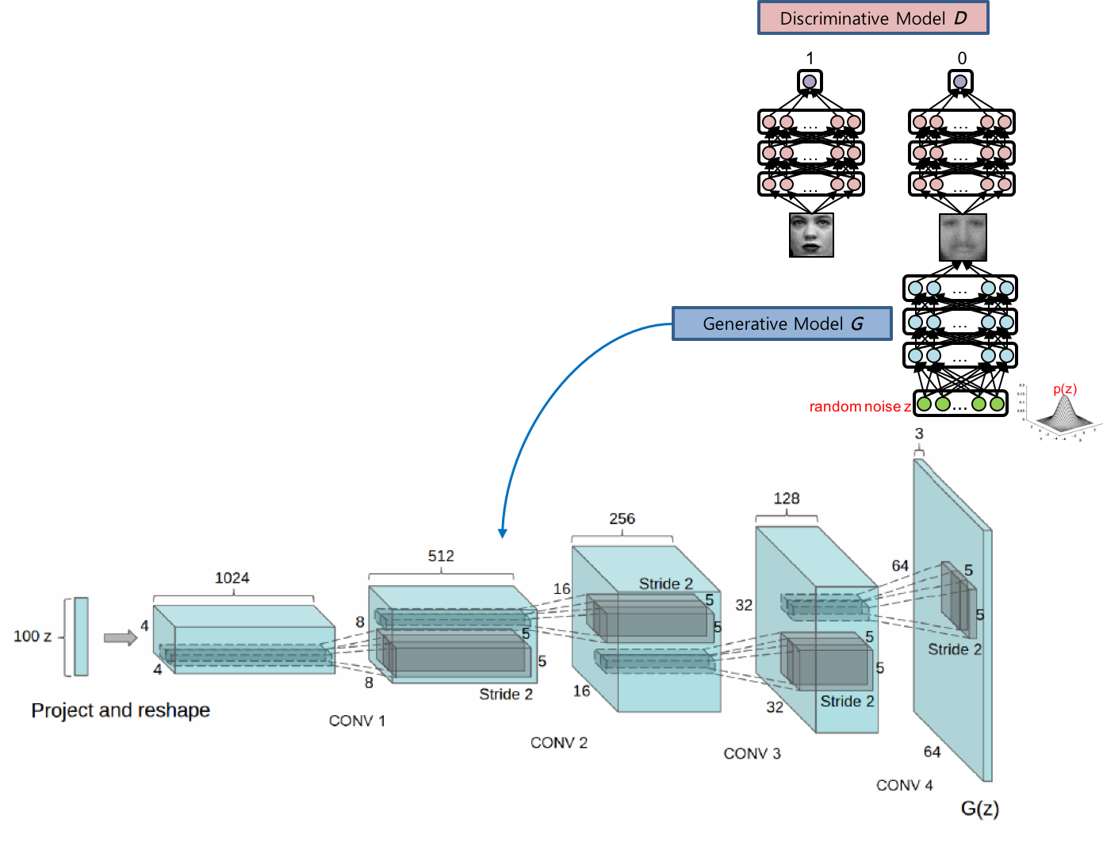
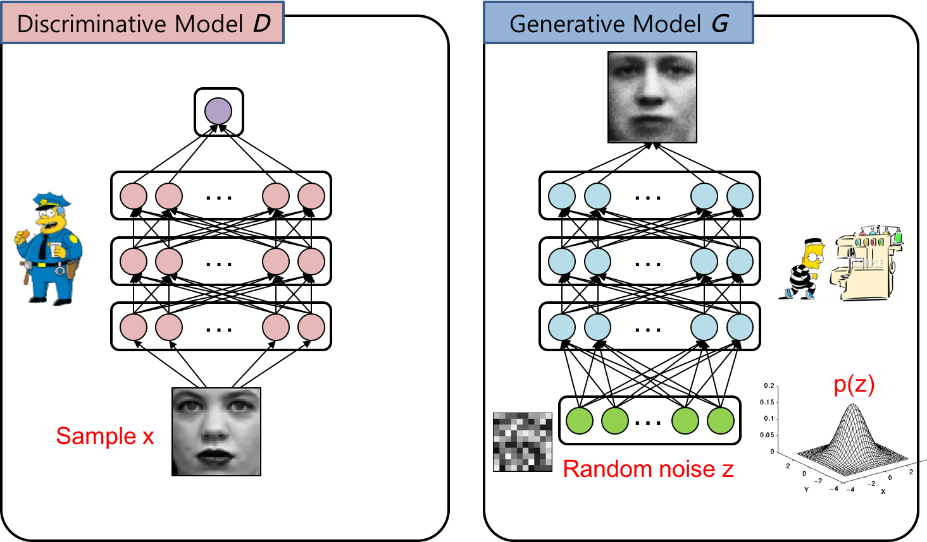
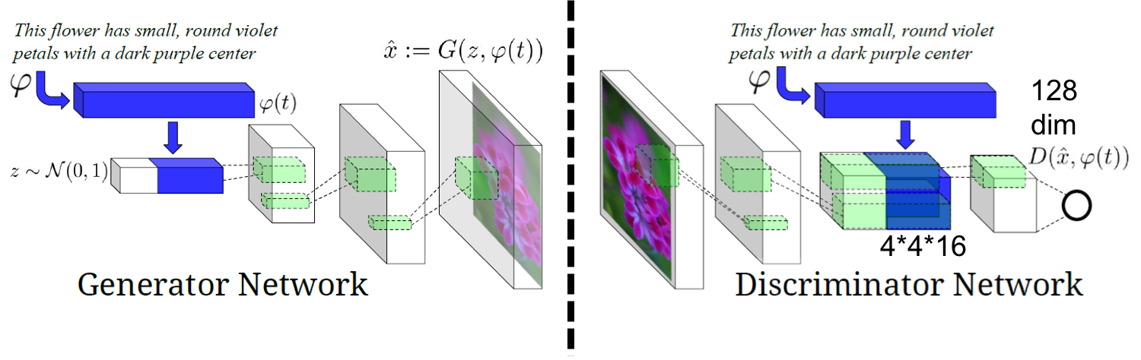
Generative adversarial networks

Slide 35
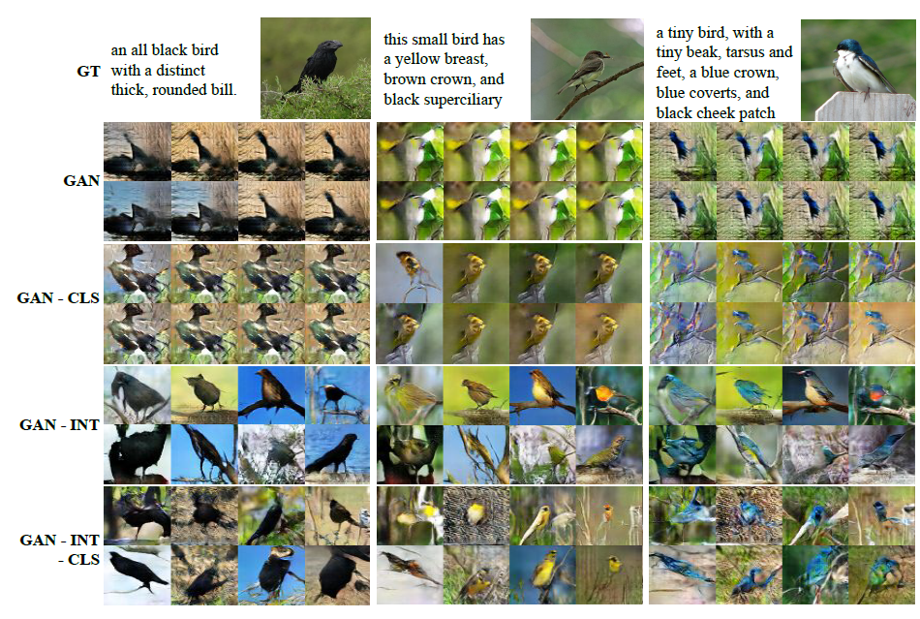
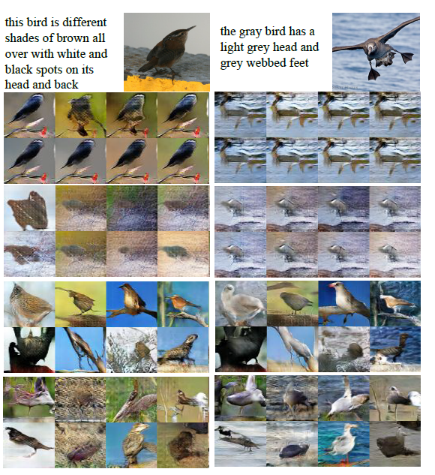
Generative Adversarial Text to Image Synthesis

Slide 36
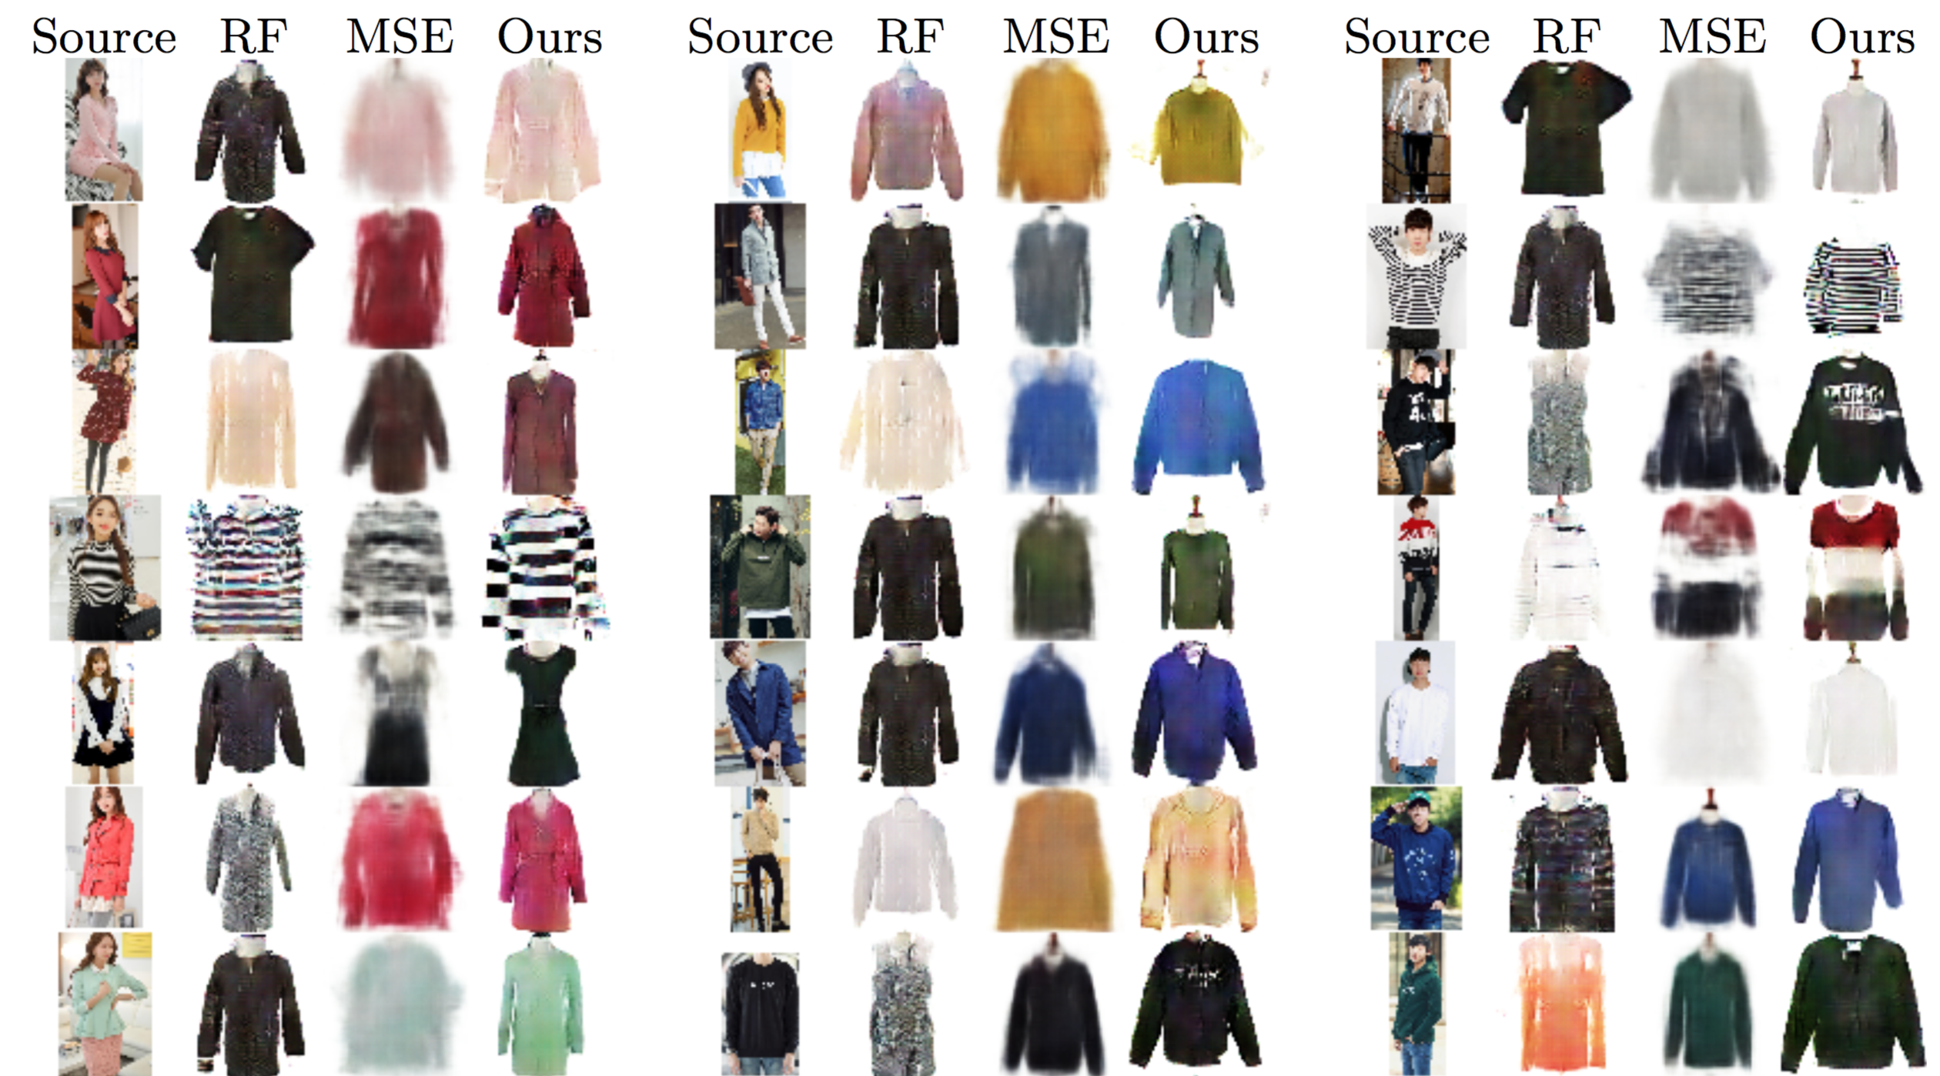
Pixel level domain transfer

Slide 37
What we will code in this course

Slide 38
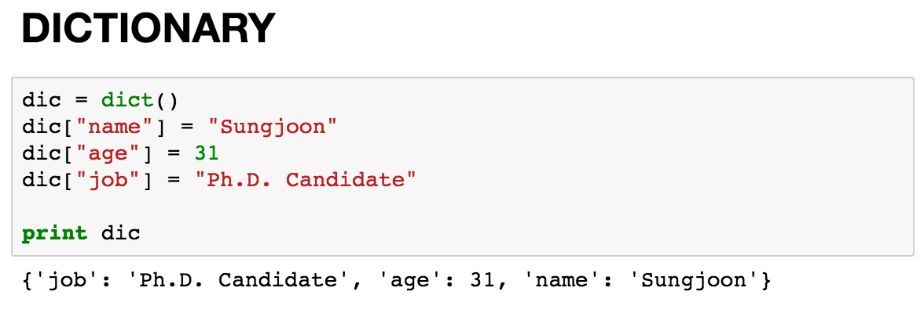
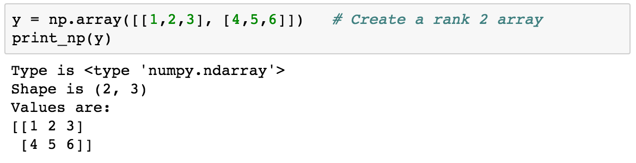
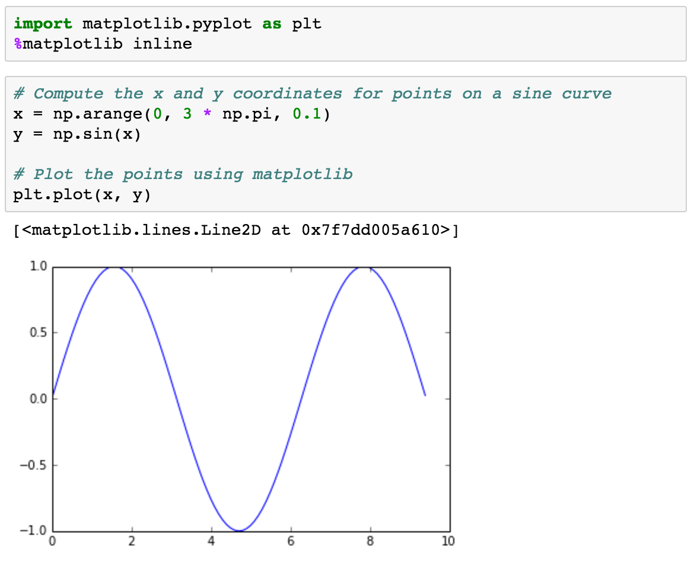
Basic Python

Slide 39
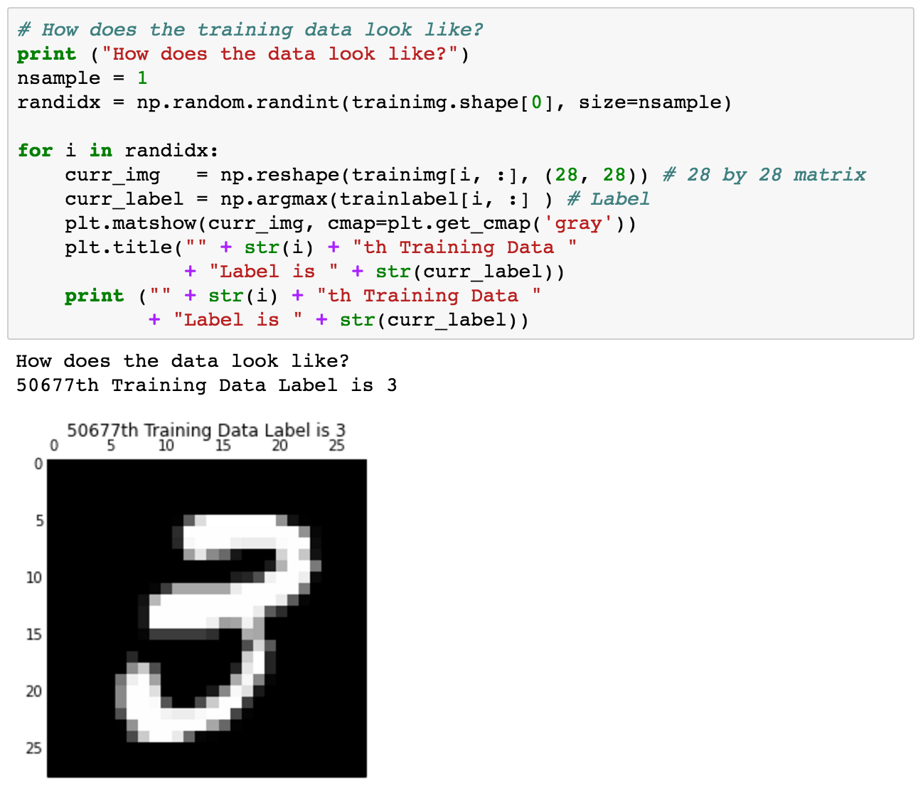
Using MNIST

Slide 40
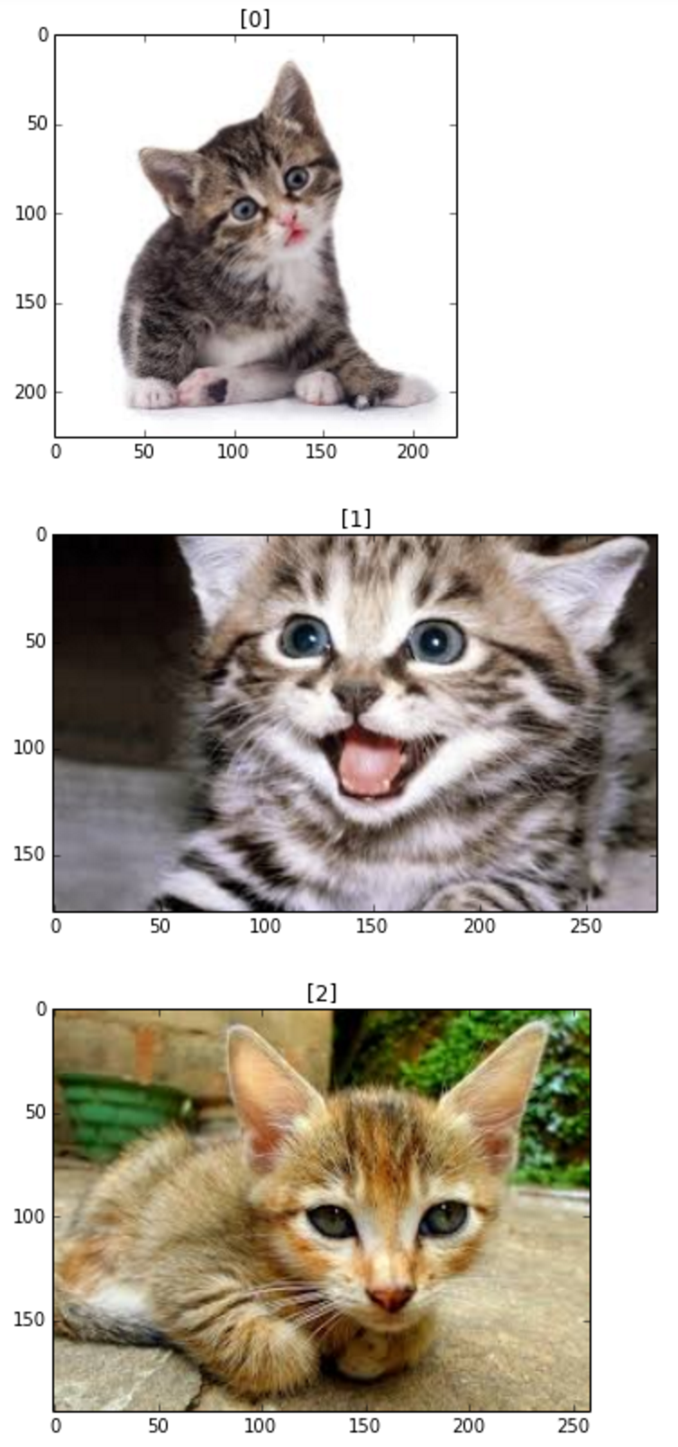
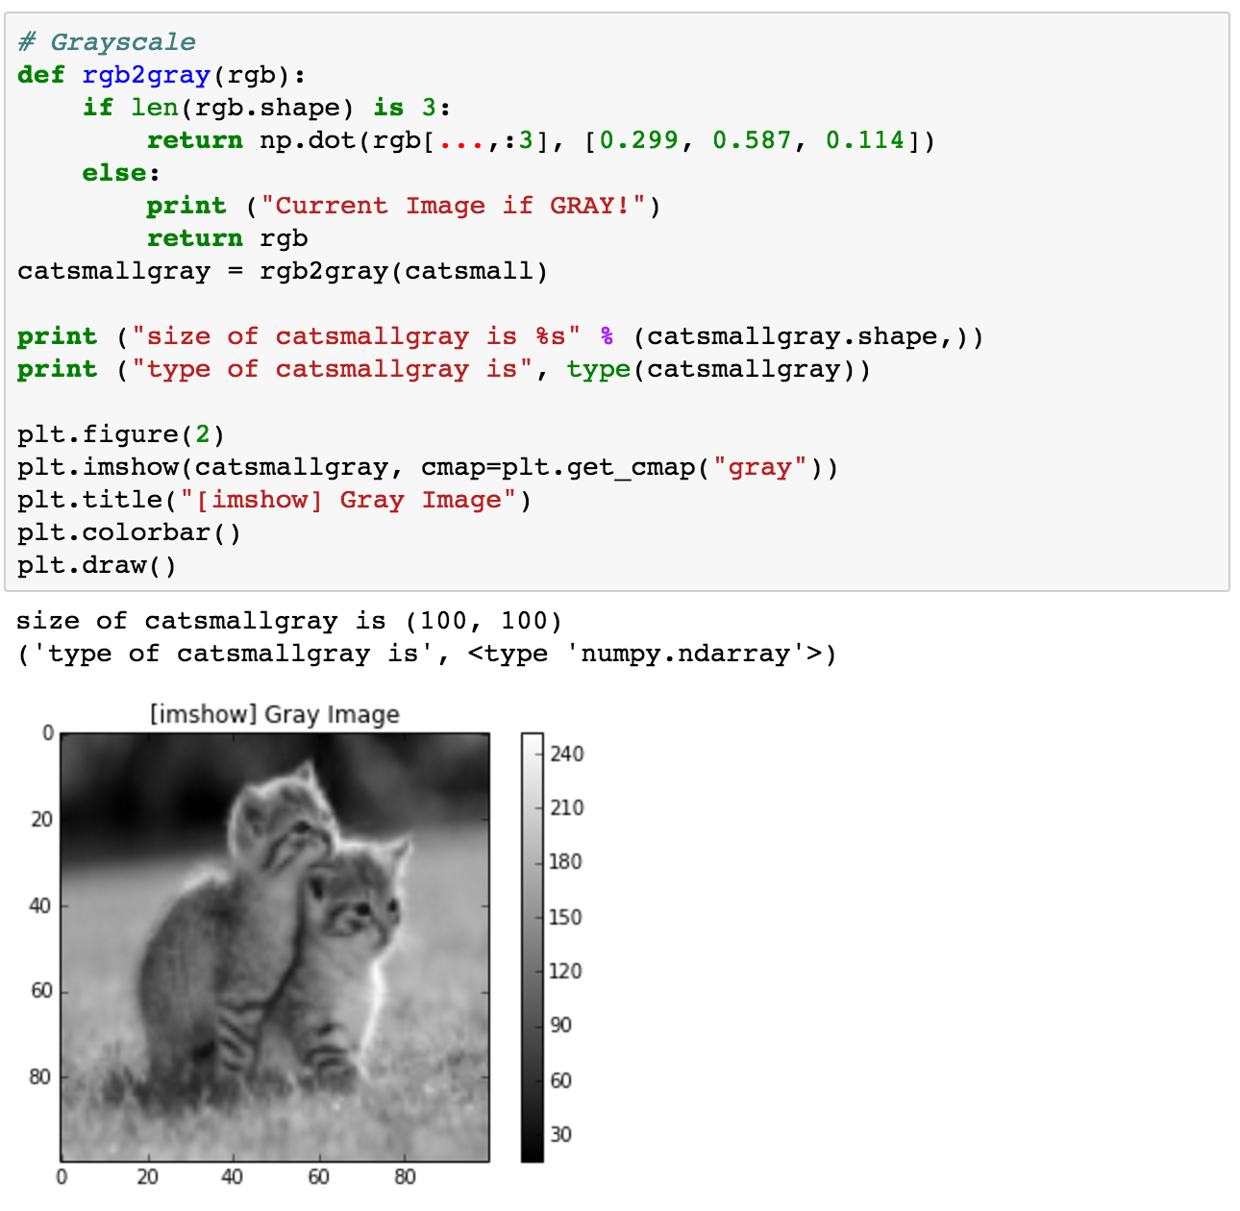
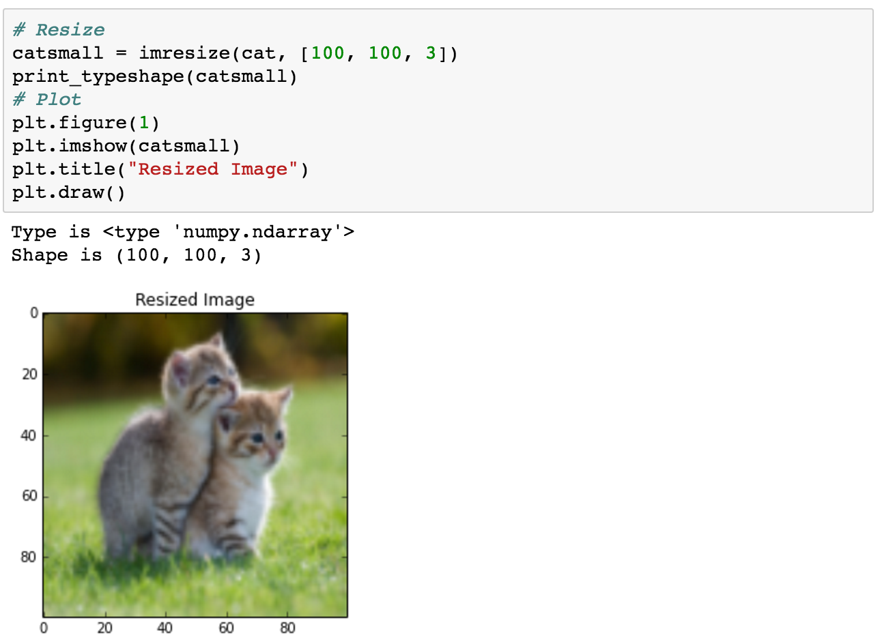
Basic image handling

Slide 41
Basic TensorFlow
Computational Graph (TensorFlow)
Optimizer
Loss
Operation
Variable
PlaceHolder

Slide 42
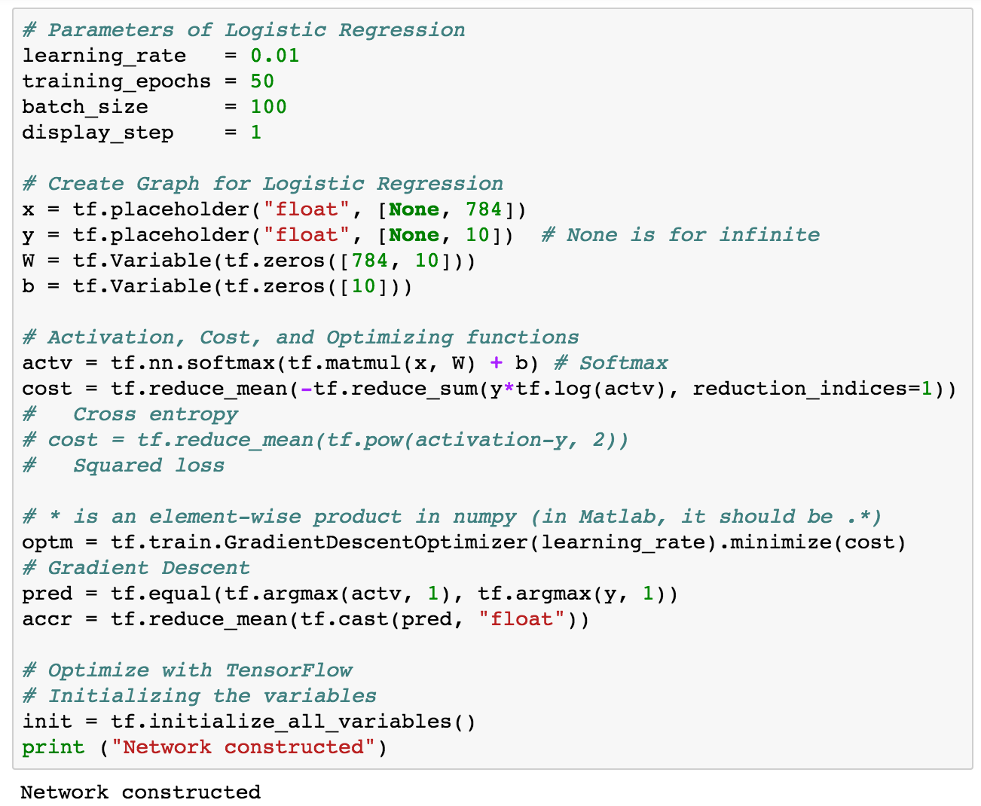
Logistic regression

Slide 43
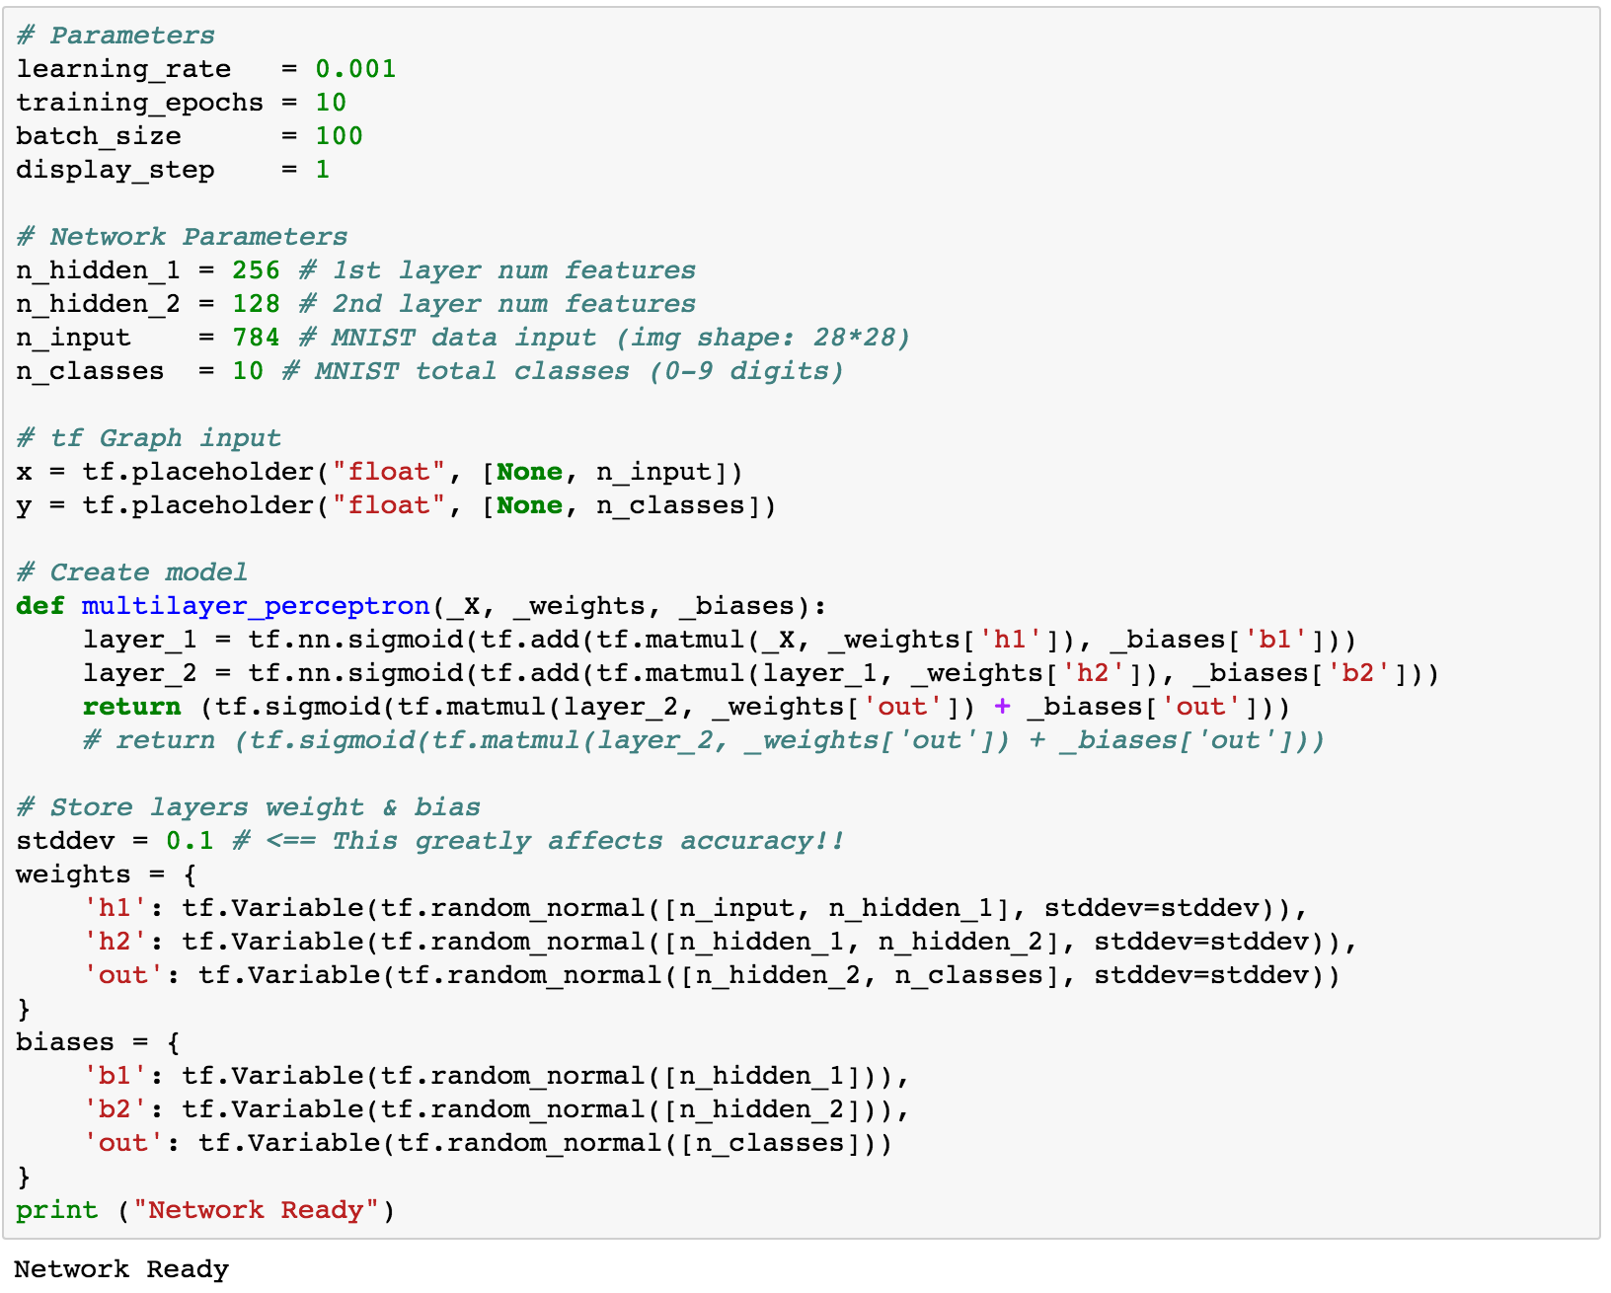
Multi-layer perceptron

Slide 44
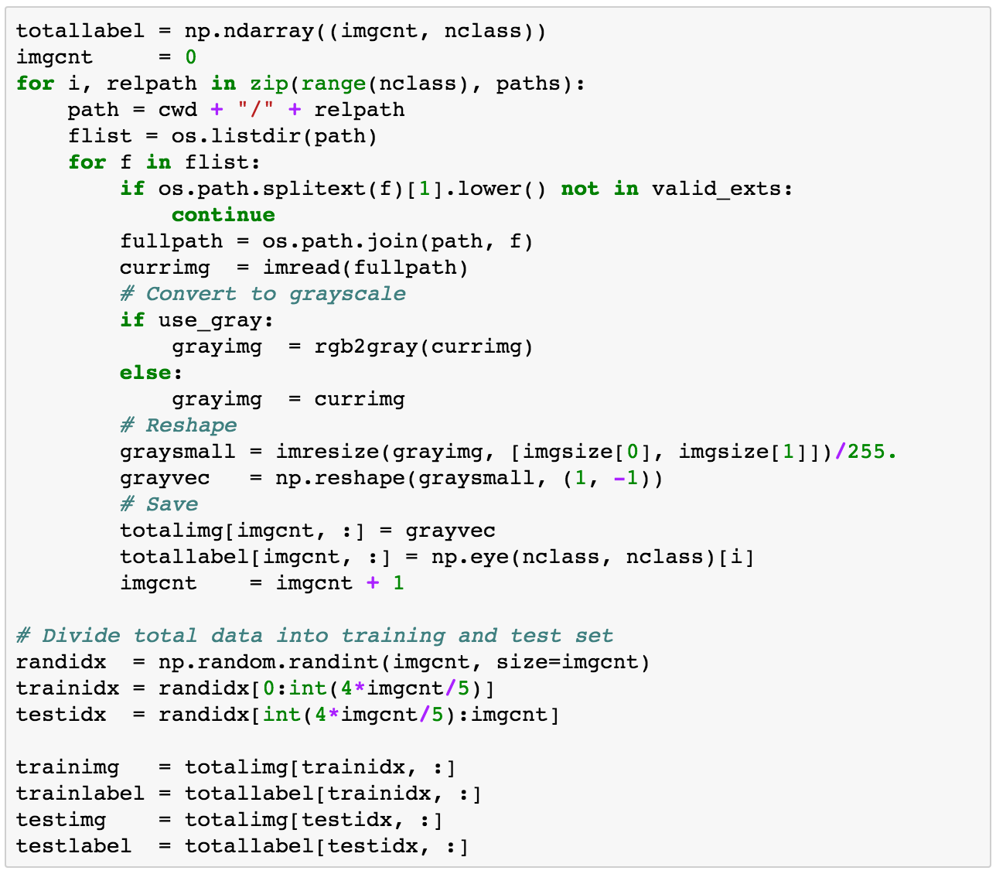
Generating own datasets

Slide 45
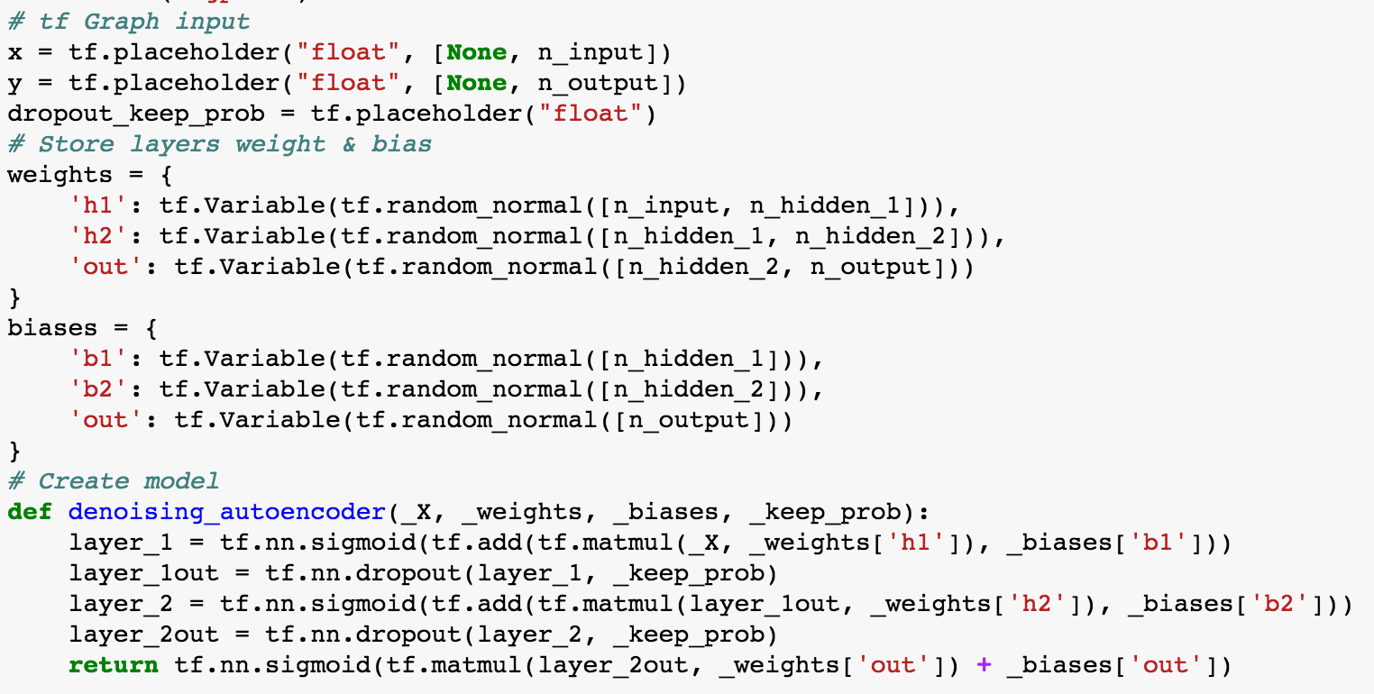
Denoising auto-encoder

Slide 46


Convolutional neural network

Slide 47


Semantic segmentation

Slide 48


TensorBoard

Slide 49

Multi-to-one RNN

Slide 50

Word2vec

Slide 51

Char-RNN

Slide 52




Neural style

Slide 53
Advanced Topics This is optional.

Slide 54
One-shot learning
2016 One-shot Learning with Memory-Augmented Neural Networks
2016 Matching Networks for One Shot Learning

Slide 55
Domain adaptation
2016 Domain Separation Networks
2016 Domain-Adversarial Training of Neural Networks

Slide 56
Metric learning
2015 DEEP METRIC LEARNING USING TRIPLET NETWORK
2016 Deep Metric Learning via Lifted Structured Feature Embedding

Slide 57
Adversarial learning
2016 Domain-Adversarial Training of Neural Networks
2016 Energy based GAN

Slide 58
Other interesting papers
2016 Learning without Forgetting
2016 Unsupervised Learning for Physical Interaction through Video Prediction

